Slide 1
2D and 3D feature-based alignment

Slide 2
Objectives
Learn about feature-based alignment
Learn about 2D alignment using least squares, as well as some related algorithms
Understand how 3D alignment works
Their applications

Slide 3
Feature-Based Alignment
After extracted features from images → match these features across different images(the set of matching features is geometrically consistent)
Feature-based alignment is the problem of estimating the motion between two or more sets of matched 2D or 3D points.
In the technique, a sparse set of features are detected in one image and matched with the features in the other image. A transformation is then calculated based on these matched features that warp one image onto the other.
Notes:
Unlike direct methods, feature-based alignment relies on feature correspondences between images

Slide 4
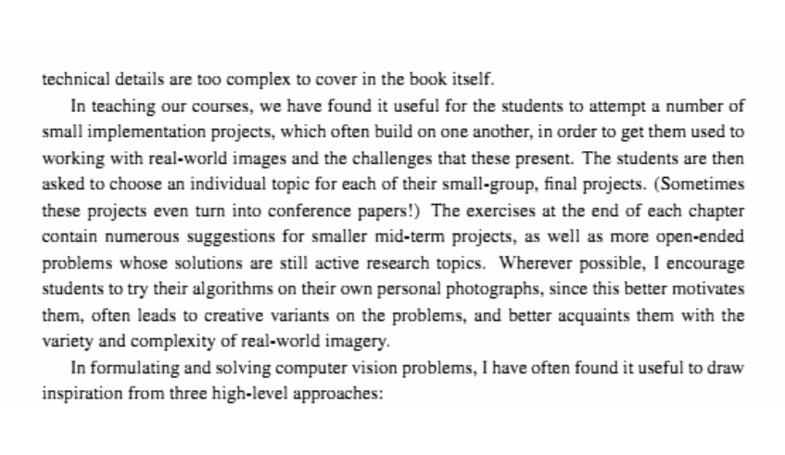
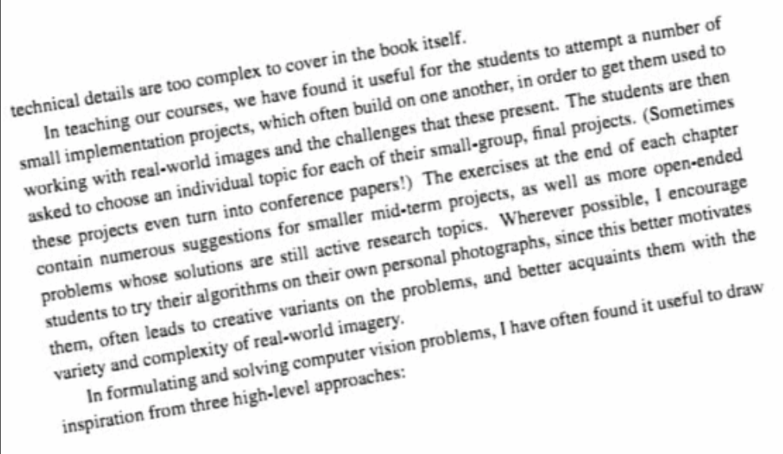
Feature-Based Alignment

Slide 5
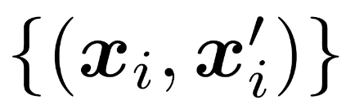
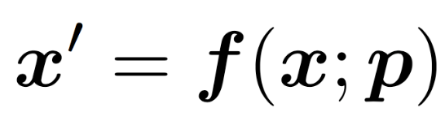
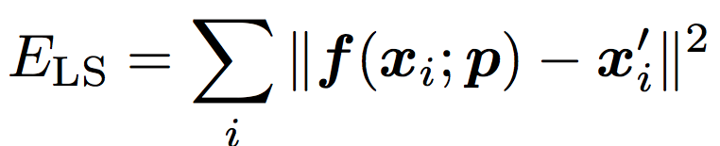
2D alignment using least squares
Give a set of matched feature points:
where xi – point in one image, x’i – point in the other image
A transformation:
where f – transformation function, p is parameters
How to find the best estimate of p?→ Least Squares Error:

Slide 6
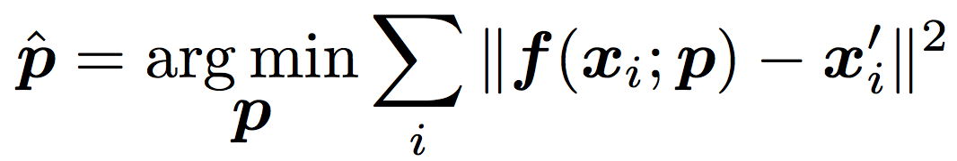
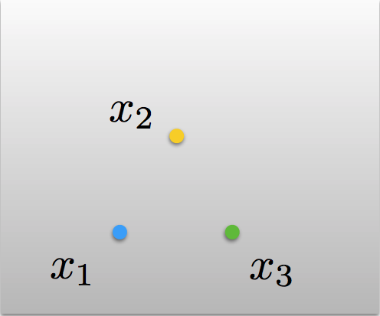
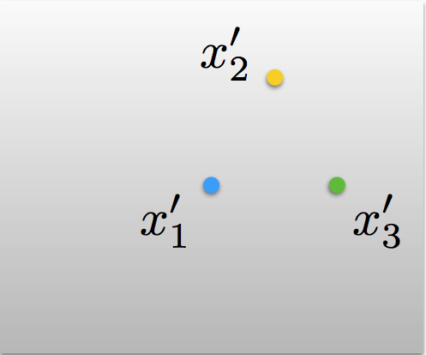

2D alignment using least squares
Find the parameter that minimize squared error:

Slide 7
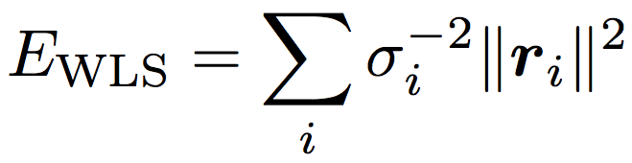
2D alignment using least squares
Uncertainty weighting→ minimize the weighted least squares problem:

Slide 8
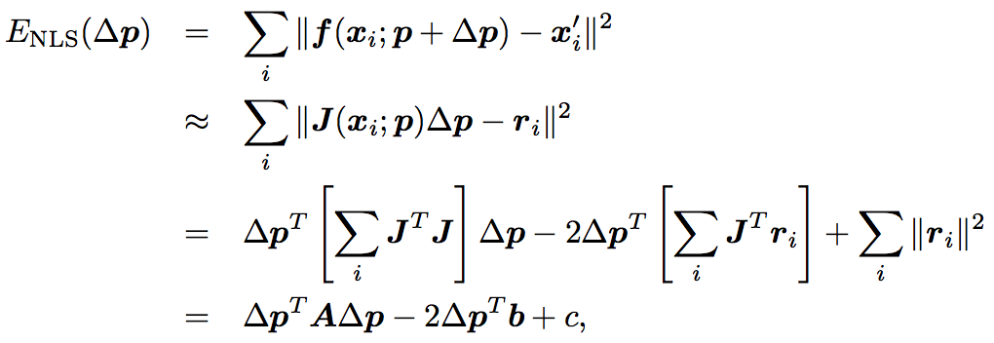

Iterative algorithms
Most problems in computer vision do not have a simple linear relationship between the measurements and the unknowns
The resulting problem is called non-linear least squares
To minimize the non-linear least squares problem:

Slide 9
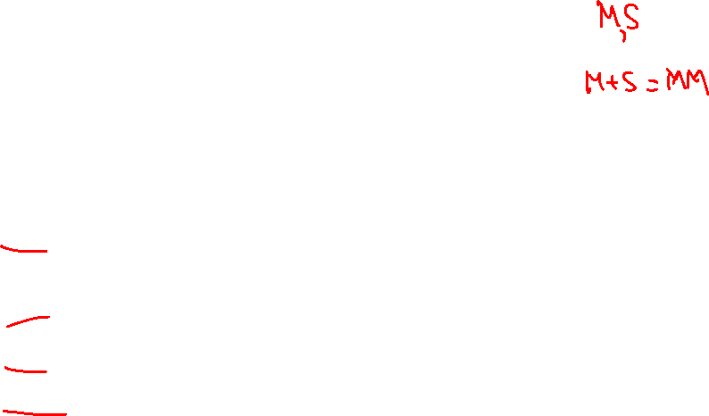
Robust least squares
Robust least squares refer to a variety of regression methods designed to be robust, or less sensitive, to outliers:
M-estimation addresses dependent variable outliers where the value of the dependent variable differs markedly from the regression model norm
S-estimation is a computationally intensive procedure that focuses on outliers in the regressor variables.
MM‑estimation is a combination of S‑estimation and M‑estimation. The procedure starts by performing S-estimation, and then uses the estimates obtained from S‑estimation as the starting point for M‑estimation.

Slide 10
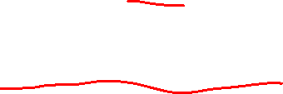
RANdom SAmple Consensus- RANSAC
RANSAC is a parameter estimation approach designed to cope with a large proportion of outliers in the input data
RANSAC is a resampling technique that generates candidate solutions by using the minimum number of data points required to estimate the underlying model parameters.

Slide 11
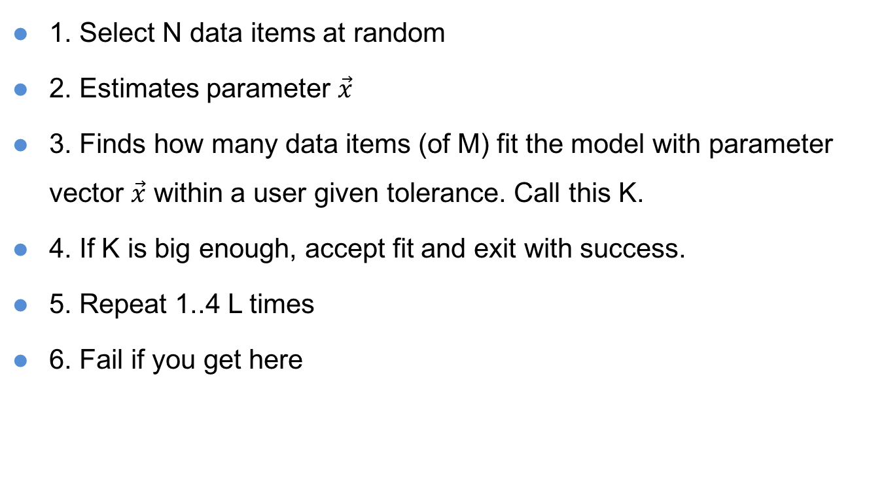
RANSAC Algorithm
1. Select N data items at random
2. Estimates parameter $\vec{x}$
3. Finds how many data items (of M) fit the model with parameter vector $\vec{x}$ within a user given tolerance. Call this K.
4. If K is big enough, accept fit and exit with success.
5. Repeat 1..4 L times
6. Fail if you get here

Slide 12
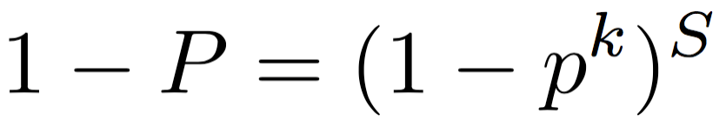
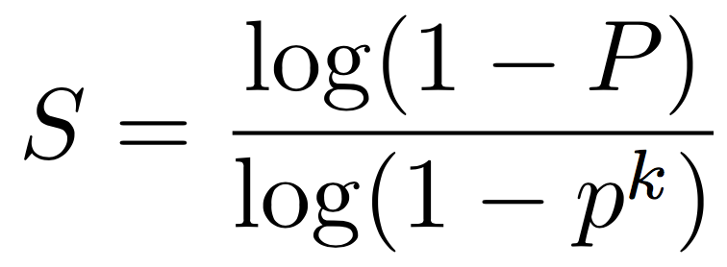
RANSAC Algorithm
The likelihood that S such trials will all fail is
The required minimum number of trials is

Slide 13
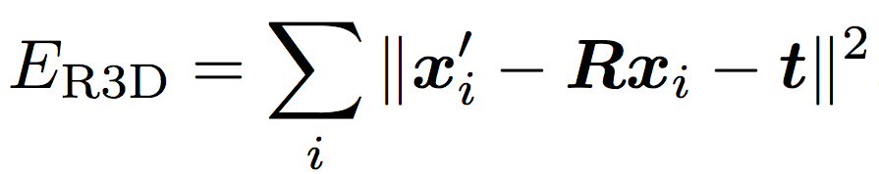
3D alignment
If the 3D transformations are linear in the motion parameters → regular least squares can be used.
The case of rigid (Euclidean) motion

Slide 14
3D alignment
The orthogonal Procrustes algorithm
The absolute orientation algorithm
→ find that the difference in accuracy is negligible

Slide 15
Applications
Document processing: align the scanned or photographed document to a template.
Medical applications: multiple scans of tissue may be taken at slightly different times and the two images need to compare.
Creating panoramas image

Slide 16
Summary
Learn about feature-based alignment
Learn about 2D alignment using least squares, as well as some related algorithms
Understand how 3D alignment works
Their applications

